Slide 1
Reform Efforts in the field of Local Self-Government (LSG) and Administrative-Territorial Division (ATD) in 2008-2012 Revisited Anatoliy Tkachuk

Slide 2
Old History.
In the early 20th century, the following ATD were in Ukraine (under rule of Russia): guberniya (government), povit (district), volost (township). Large cities were not included in volosts, they had their own elected governments.
In rural areas, villages around the dominant centres - towns and large villages – were included in the composition of a volost, and they did not have their own government bodies, except for a starosta (headman).
Since 1919, village councils were formed in all villages, and their number reached 18 000 (at that time, nine current regions (oblasts) did not belong to Ukraine).
In 1922, there was a restriction adopted for the creations of a village ATD: population - not less than 1 000, area - 25-40 thousand, vicinity (community) - 400-600 thousand.
The inclusion of village (rural) councils and rural rayons (areas) to the city councils took place in Donbas in the early 30-ies in order to "strengthen the agricultural base of the main industrial regions of Donbas“. (cl.4, Resolution No. 28, 1932).

Slide 3
Changes at the level of rayons
Institute of Civil Society
year | 1946 | 1962 | 1965 | 2011
Number of rayons | 750 | 231 | 393 | 490

Slide 4
UKRAINE
Autonomous Republic of Crimea
Regions (oblasts)
Municipalities
(cities with special status)
Kyiv and Sevastopol
Rayons
Cities of republican status
Rayons
Cities of regional (oblast) status
City districts
Village
Rural settlement
Village
Village
Village
City of Rayon status
Rural settlement
Rural settlement
Rural settlement
City of Rayon status
Village
City of Rayon status
Rayons *
Rural settlement
City districts
City of Rayon status
City of Rayon status
City districts
*Note:
Sverdlovsk rayon of Luhansk region (oblast) is subordinate to Sverdlovsk City Council, Krasnolymans'k rayon of Donetsk region (oblast) – to Krasnolymans'k City Council
Village
Rural settlement
Village
Rural settlement
Rural settlement
City of Rayon status

Slide 5
Alternative Solutions of the Problem
Institute of Civil Society
Conducting a comprehensive reform of ATD and LSG bodies | Gradual change of ATD ‘in a natural way’
Adopting amendments to the Constitution of Ukraine and to the laws on ATD and LSG | Waiving the elections to local self-government in "nested communities", encouraging voluntary associations of communities
Forming new communities and rayons by law | Creating administrative districts by the decree, “optimizing budget institutions"
Reducing the number of communities through their amalgamation, delegating government functions to the newly formed communities | Reducing the number of communities due to depopulation of rural areas. Transferring the authority from communities to the upper level.

Slide 6
What was done: 2008-2009
The Order of the CMU of 29.07.2009 No. 900-p "On Approval of the Concept of Local Government Reform“.
The Order of 02.12.2009 No. 1456-p "On Approval of a Plan of Actions to Implement the Concept of Local Government Reform“. Under this plan, the Ministry of Regional Development prepared draft laws "On Administrative-Territorial System", "On Local Government", "On Local State Administrations", as well as draft amendments to the Constitution of Ukraine.
The Order of the Cabinet of Ministers of Ukraine of 08.04.2009 No. 385-p "On Approval of the Concept of Forming the System of Advanced Training for Local Government Officials and Local Counselors”
The Order of 23 September 2009 No. 1134-p "On Approval of a Plan of Actions till 2011 to Implement the Concept of Forming the System of Advanced Training for Local Government Officials and Local Counselors“.
The Ministry of Regional Development and Construction prepared a draft Concept of the Administrative-Territorial Division Reform, and collegium of the Ministry approved by its decision the Method for modelling communities, pursuant to the draft Concept. All regions (oblasts) in Ukraine performed the appropriate modelling, prepared a list of new communities and maps of the regions (oblasts) with new communities.

Slide 7
What has been done: 2010-2012
The Government has not performed previously approved plans for implementation of the Concept of Local Government Reform and the Concept of Forming the System of Advanced Training for local government officials and local counsellors.
The Verkhovna Rada of Ukraine passed the Law of 07.09.2010 No. 2500-VI initiated by the Government “On Amendments to the Law of Ukraine “On the capital city of Ukraine – hero-city Kyiv“ in terms of the formation of district councils”, which ultimately restricted local government in the capital city: the city Mayor was no longer in charge of the executive body, district councils were abolished in the city districts, and there were no local elections in 2010 in Kyiv.
The Verkhovna Rada of Ukraine adopted the Law of 10.07.2010 No. 2487-VI «On Elections of Deputies of the Verkhovna Rada (Supreme Council) of the Autonomous Republic of Crimea, local councils and heads of villages, rural settlements (townships) and cities“, which allowed the ruling party to gain the advantage in elections and the victory even in the areas where traditionally there is no voters’ support.
The Ministry of Regional Development and Construction prepared the draft law "On the Association of Communities“, which was submitted for consideration of the Verkhovna Rada of Ukraine under No. 9590 of 14.12.2011; however, it neither solves the issues of the Administrative-Territorial Division Reform, nor it can be implemented in the proposed form in practice. A number of draft laws initiated both by the Government and People's Deputies of Ukraine, related to the area of local government and administrative-territorial division, have been registered in the Verkhovna Rada of Ukraine:

Slide 8
Draft Laws
940403.11.2011 Draft Law on Local Initiatives
943509.11.2011 Draft Law on Administrative Services
959014.12.2011 Draft Law on Associations(Amalgamation) of Territorial Communities
964626.12.2011 Draft Law on the Concept of Local Self-Government Reform
967311.01.2012 Draft Law on Service in Local Government
973819.01.2012 Draft Law on the Territorial Arrangement of Ukraine
1002509.02.2012 Draft Law on Local and Regional Government in Ukraine

Slide 9
Concepts
Project of the Institute of Civil Society – 2008,
Project of the Ministry of Regional Development and Construction – 2009,
Project of the Association of Ukrainian Cities – 2009,
Project of the Association of regional (oblast) and rayon councils -2011,
Project of the Ministry of Regional Development and Construction – 2012
Draft of Vinnytsya Regional (Oblast) Council in 2011
Despite the formal existence in the information area of several concepts of the reform of local government and administrative-territorial division, we can assert that at the level of the system, there are elements, which can not be questioned by the authors of the Concepts, by municipal and political environment, and which are reflected in the messages of the President of Ukraine

Slide 10
Common stands in all draft Concepts
The ATD system should have three-levels: region (ARC, oblast), rayon, community.
Local governments at all ATD levels are to be represented by councils and their executive bodies.
The basic level of local government is a community that is created based on one or more settlements on the basis of the centres of economic growth.
Local state administrations are losing a significant part of their current powers and acquire characteristics of oversight bodies over the activities of local self-government and over the performance of individual executive functions in areas that are not assigned or delegated to LSG.
The jurisdiction of LSG covers the whole territory of ATD, which is the territorial basis of this local government body. The powers between LSG of different levels of ATD are clearly differentiated.

Slide 11
The Interim Conclusion
Given the official statements of the heads of the EU Mission in Ukraine on the connection between the budget support to Ukraine and the fulfilment of its commitment to create a European system of development and implementation of the state regional policy, decentralization of power, formation of public service and possible changes in the Cabinet of Ministers of Ukraine, work on the projects in the determined areas might be intensified significantly in the near future; but the eventual adoption of regulations that would meet the needs of the society is very unlikely.

Slide 12
The way it was, the way it is, and the way it can be
Within the Russian Empire, Russian part of Ukraine was divided into 12 guberniyas (governments), 4 of which were only partially located in Ukraine, 102 povits (districts) and 1989 volosts (townships).
As of 26.05.09, Ukraine is comprised of 27 regions, 490 rayons, 118 districts in cities, 177 cities of regional (oblast) status, 280 cities of rayon status, 784 settlemens (township) councils and 10,278 village councils.
After the reform - 25 regions, up to 150 rayons, up to 1800 communities. Kyiv and Sevastopol are the cities with special status .

Slide 13
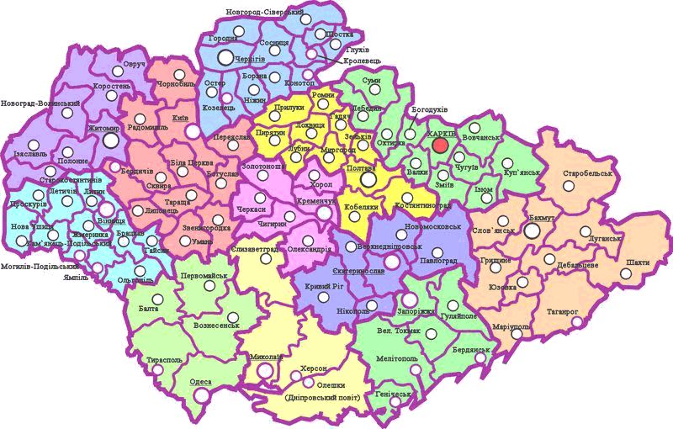
Povits (districts) in guberniyas (governments), 1920

Slide 14
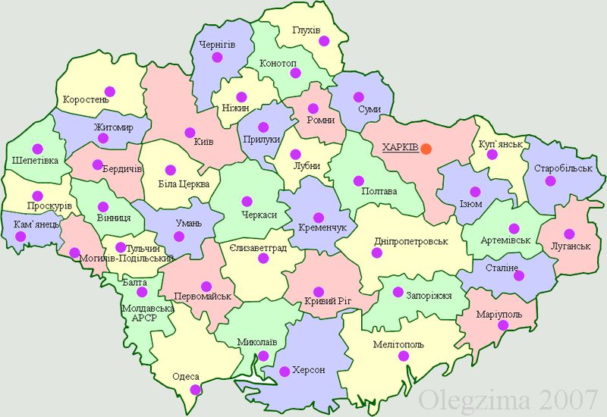
Okrugs (counties) in Ukraine, 1927

